Slide 1




EU Sustainability Reporting standards
Franco Amelio - 26 March 2021

Slide 2
The ambitious EU momentum for sustainability reporting
Background
2014
2017
2018
2019
2020
NextGeneration EU
Taxonomy
Sustainable Corporate Governance
2021
Renewed Sustainable Finance Strategy Consultation
NFRD Revision First draft in April
Green Deal
Action plan on financing sustainable growth
SFDR
NFRD EC
Consultation + NBG on reporting climate info.
NFRD
Non-binding guidelines (NBG)
On top of these main texts, the EFRAG Lab Project Task force on Non-Financial Reporting Standards (PTF-NFRS) identified 29 different EU legislative initiatives - existing and forthcoming - regarding Company disclosures, Data intermediaries, Institutional use of company data and Retail investors and citizens.
Copyright © 2021 Deloitte SAS. All rights reserved
2

Slide 3
The ambitious EU momentum for sustainability reporting
NFRD Revision: 3 sub-processes in parallel to prepare for a full legislative process
Preparatory Work for NFRD revision
Possible steps forward
NFRD Revision at EC level (Commission)
Level 1 Draft
21 April 2021?
Draft by Mid 2022
Draft by Mid 2023
Draft by Mid 2024
and beyond
Standards
EFRAG Governance (JP. Gauzès Ad Personam)
1st set of standards |  | 2nd set of standards |  | Following sets of standards
SMEs standards |  |  |  | SMEs update
Sector-specific standards
Report
8 March 2021
Standard-Setting Preparatory Work (EFRAG Lab PTF-NFRS)
Report
8 March 2021
Application
2023
(Reports published in 2024)
2024
(Reports published in 2025)
2025 and beyond
Copyright © 2021 Deloitte SAS. All rights reserved

Slide 4
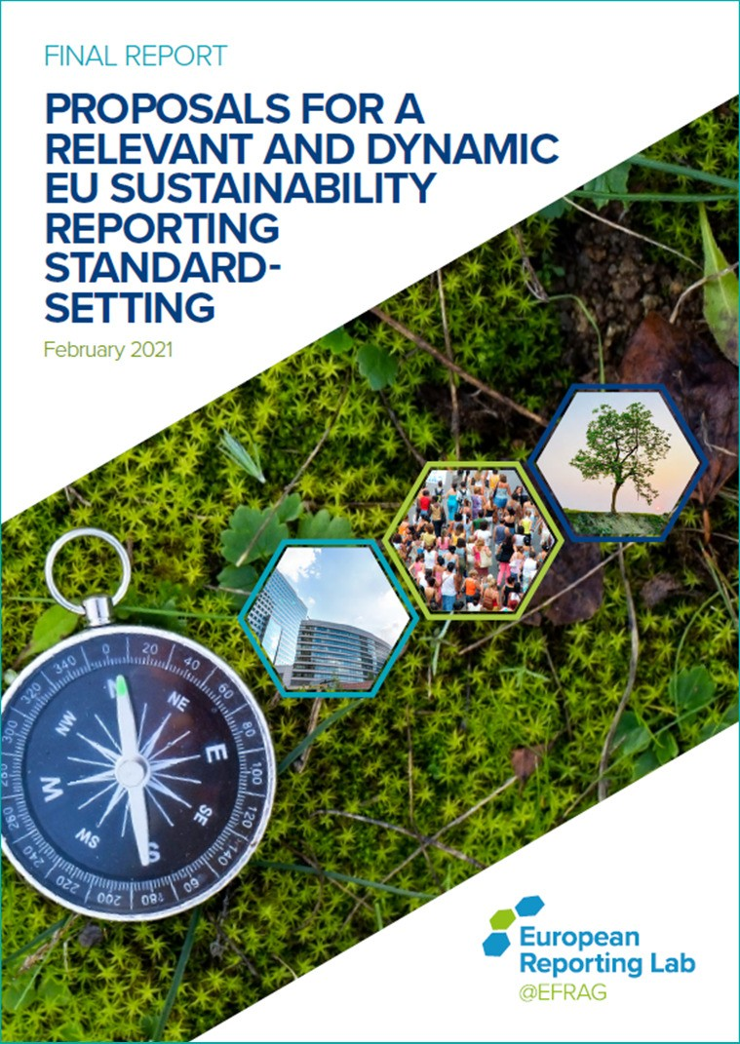
EFRAG Lab PTF-NFRS Report
EU Sustainability Reporting standards
Copyright © 2021 Deloitte SAS. All rights reserved
4

Slide 5
The EFRAG Lab PTF-NFRS Report
A first-in-kind comprehensive report paving the way for possible European Standard-Setting (ESS)
Objective of the report: draw the possible roadmap and way forward for the possible standard-setter depending upon the final content of the revised NFRD
Context elements to be confirmed at legislative level (Level 1):
Mandatory standards, to be adopted by the European Commission via Delegated Acts
Scope: possible extension of the scope of application to all large companies (i.e. ≥ 250 FTE, listed or not), voluntary application for SMEs (i.e. < 250 FTE)
Double materiality concept
Location of sustainability statements, whether in the management report or a separate report
Assurance level for sustainability information (limited assurance)
Digital tagging
Copyright © 2021 Deloitte SAS. All rights reserved
5

Slide 6

EU sustainability reporting standards
A first-in-kind comprehensive report paving the way for possible European Standard-Setting (ESS)
Introduction: Purpose of sustainability reporting
1. Foundations
2. Conceptual Guidelines
2 overarching principles: Principle-based, Inclusive range of stakeholders
6 building-blocks: 1. Supporting the EU momentum,
Building on and contributing to global convergence,
Adressing Financial Institutions specific challenges,
Including SMEs, 5.Fostering sector-specific information,
6. Acknowledging the importance of intangibles
Public good and public policy alignment
Quality of information
Retrospective and forward-looking information
Levels and boundaries of reporting
Double materiality
Connectivity
3. Target architecture
3 Layers
Sector- agnostic
Sector- specific Entity- specific
3 Reporting areas: Strategy, Implementation, Performance measurement
3 Topics: Environment, Social, Governance+
Sustainability Reporting = Sustainability Statements
3. Roadmap
Roadmap and co-construction with international standard-setters and initiatives
Copyright © 2021 Deloitte SAS. All rights reserved

Slide 7
EU sustainability reporting standards
A first-in-kind comprehensive report paving the way for possible European Standard-Setting (ESS)
Introduction – Anchoring the double materiality concept in the Purpose of sustainability reporting
“The PURPOSE of publicly available sustainability reporting is to provide relevant, faithful, comparable and reliable information:
On (i) material sustainability impacts of the reporting entity on affected stakeholders (including the environment) [impacts materiality] and (ii) material sustainability risks and opportunities for its own value creation [financial materiality],
Enabling users of information (i) to understand the reporting entity’s sustainability objectives, position and performance and (ii) to inform their decisions relating to their engagement with the entity.”
Sustainability reporting is directly related to management reporting systems enabling reporting entities to better understand, manage sustainability matters and ultimately improve sustainability performance.
(IFRS Foundation strategic direction – 8 March 2021 ⇨ Developing sustainability standards with an Investor focus for enterprise value, i.e. Information material to the decisions of investors, lenders and other creditors [financial materiality] ⇨ < scope than EU)
CONTEXT
Standard-setting in the EU should build on, and contribute to, relevant international initiatives in order to foster global convergence over time. The EU’s next steps should be implemented in a spirit of cooperation and partnership with international initiatives and partners (‘co-construction’) in order to converge efforts without slowing down the momentum achieved in the EU nor undermine its level of ambition.
Sustainability information aims at better capturing the interactions between the reporting entities and their stakeholders, as well as their mechanisms of value creation.
(IFRS Foundation strategic direction – 8 March 2021 ⇨ Develop sustainability standards allowing a building block approach for key
jurisdictions, so as to provide a globally consistent and comparable sustainability reporting baseline, while also providing flexibility for coordination on reporting requirements that capture wider sustainability impacts)
Copyright © 2021 Deloitte SAS. All rights reserved
7

Slide 8



EU sustainability reporting standards
A first-in-kind comprehensive report paving the way for possible European Standard-Setting (ESS)
Rolling out a phased-in standard-setting roadmap
Given the level of urgency and EU ambition to move swiftly, the PTF recommends that the ESS be implemented in phases, with an enhancement of content approach, to eventually achieve the target architecture and a robust sustainability standards platform over time.
The PTF mentioned in particular the importance
to build on TCFD recommendations for climate change from a financial materiality
perspective,
to ensure consistency with the disclosures required under the SFDR; and
to address SMEs needs fully, considering the increasing demand and pressure they face from their stakeholders for sustainability information, whether in the scope of the NFRD
or not.
Draft by Mid 2022
Draft by Mid 2023
Draft by Mid 2024
and beyond
Target architecture
2 conceptual guidelines, cross-cutting standards
4 conceptual guidelines, cross-cutting standards update
+
Standards
+
‘Core’ topical standards
Further ‘Advanced’ topical standards
Sustainability Reporting Platform
‘Advanced’ topical standards
SMEs standards
SMEs update
Sector-specific standards
Application
2023
(Reports published in 2024)
2024
(Reports published in 2025)
2025 and beyond
Copyright © 2021 Deloitte SAS. All rights reserved
8

Slide 9



About Deloitte
Deloitte refers to one or more of Deloitte Touche Tohmatsu Limited (“DTTL”), its global network of member firms, and their related entities (collectively, the “Deloitte organization”). DTTL (also referred to as “Deloitte Global”) and each of its member firms and related entities are legally separate and independent entities, which cannot obligate or bind each other in respect of third parties. DTTL and each DTTL member firm and related entity is liable only for its own acts and omissions, and not those of each other. DTTL does not provide services to clients. Please see www.deloitte.com/about to learn more.
Copyright © 2021 Deloitte SAS. Member of Deloitte Touche Tohmatsu Limited. All rights reserved.

